Slide 1

A/B TEST ON THE HOTEL BOOKING WEBPAGE
Peisu Wang

Slide 2
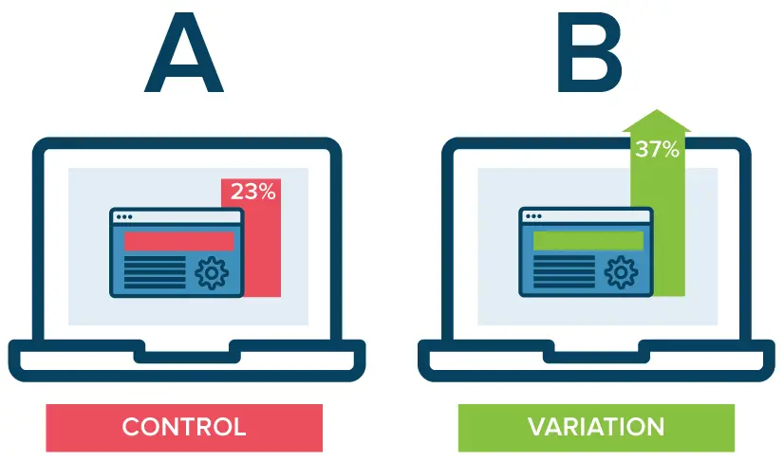
Introduction – What is the A/B test?
A/B testing is a methodology for comparing two versions of a webpage against each other to determine which one performs better based on the metrics we choose.
In an A/B test, we take a webpage and modify it to create a second version of the same page and run the statistical analysis to determine which variance has a better performance.

Slide 3


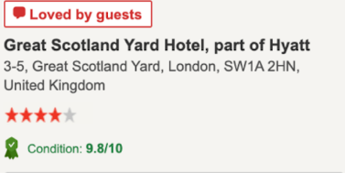
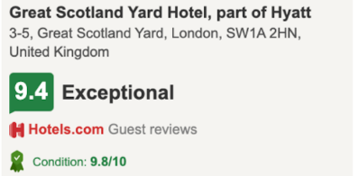
Introduction – Background
We are comparing the ‘Price Panel’ of a hotel’s booking form where we show key information on the stay with displaying star ratings (control) against customer ratings (variant).
SEE FOR YOURSELF!
CONTROL
VARIANT

Slide 4
Primary Metrics
Total Booking Sales
Total revenue of the company
What do we test for?
Purchase/view rate
Conversion rate of the webpage visitors
In an A/B test, the primary metric determines whether the test “wins” or “loses. Secondary metrics provide additional information about the visitors' behaviour in the vicinity of your change and across your site.
Secondary Metrics
Length of stay
Number of days that customers stay
Average sales per day
Average sales per night

Slide 5
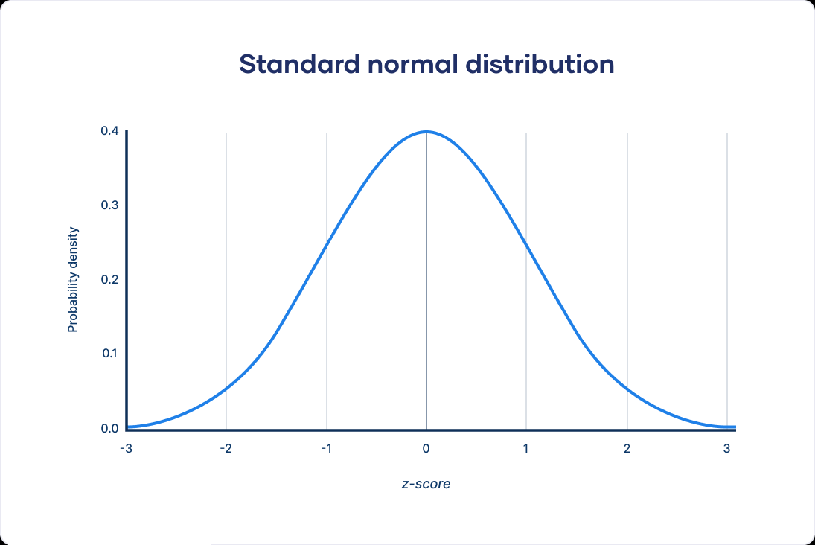
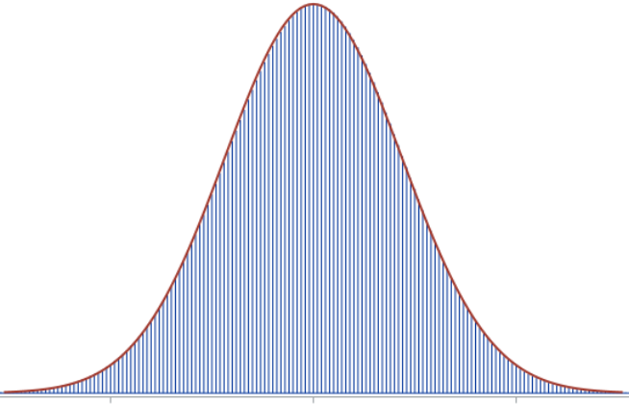
Two main models
Binomial distribution

Slide 6
Numerical Result
+0.28%
-$12.32
+0.017
-$11.67
Purchase/view rate
Average sales per customer
Length of stay / day
Average sales per day
Increase
By 0.71%
Significant change
Insignificant by sample size
Decrease
By 6.32%
Significant change
Test is nearly 100% correct
Increase
By 1.30%
Insignificant change
Increase
By 7.87.30%
Significant change
Test is nearly 100% correct

Slide 7
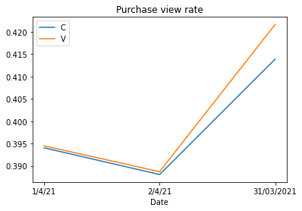
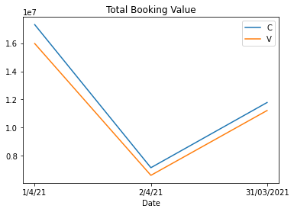
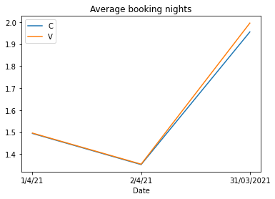
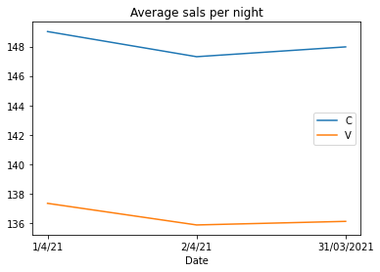
Graphical Result by Dates

Slide 8
Financial Impact
Date
Values
$ 1,871,038.4
$ 83,089,696,900
31/03
- 6.67%
01/04
- 6.05%
Three days lost
02/04
- 6.12%
Annual lost
DECREASE PERCENTAGE
6.3%

Slide 9
Conclusions
The strong negative effect on the total booking sales overweighs the benefit of the improvement in purchase/view rate and length of stay.
On the other hand, the length of stay increased by 1.30% while the sales per night dropped by 7.87%, which decreases faster than it increases. This means even with the longer stay time, we can still end up with a decrease in total sales.
We know PowerPoint can be overwhelming, with all the layouts, shapes, charts, and fonts. On top of that, creating slides you’re really satisfied with can take up HOURS of your busy schedule. But not today! Focus on polishing your ideas and leave the designing to us.
How about using this template as your first draft?
Just fill in the content and send it our way. We’ll make sure your final PowerPoint looks exactly as you envision it!
Recommendations
Use the webpage that displays star ratings instead of customer ratings!

Slide 10
THANK YOU

